Slide 1


Capstone Project Phase B smell Classification and Identification 24-1-R-1
Amit Malca
Liel Pasman
Supervisor: Mr. Ilya Zeldner

Slide 2

Introduction
Importance of smell analysis
Perfumery and Cosmetics
Food industry
Technology and Communication
1
Introduction
Importance of smell analysis

Slide 3
Introduction
The problem
Smell absorption
Smell identification and characterization analysis
Preparing the output for the input the smell creation phase
Create new smell
1
2
Introduction
Importance of smell analysis
Introduction
The problem

Slide 4
Introduction
Our solution
Classification smells
Using deep learning algorithms
Application
1
2
3
Introduction
Importance of smell analysis
Introduction
The problem
Introduction
Our solution

Slide 5
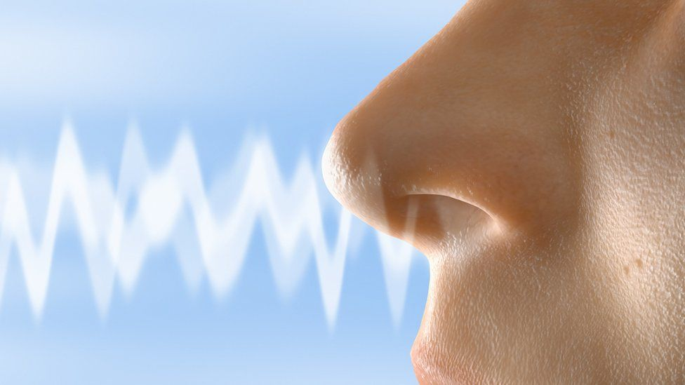
BackGround
Conditions for a molecule to be called an odorant
Lack of uniformity in smell analysis
1
2
3
4
Introduction
Importance of smell analysis
Introduction
The problem
Introduction
Our Solution
BackGround

Slide 6
BackGround
Previous Researches
Imbalance in the databases
Using chemical prediction techniques with limitations in interpretation.
Limiting the comparison and classification of only two smells at a time.
1
2
3
4
5
Introduction
Importance of smell analysis
Introduction
The problem
Introduction
Our Solution
BackGround
BackGround
Previous Researches

Slide 7
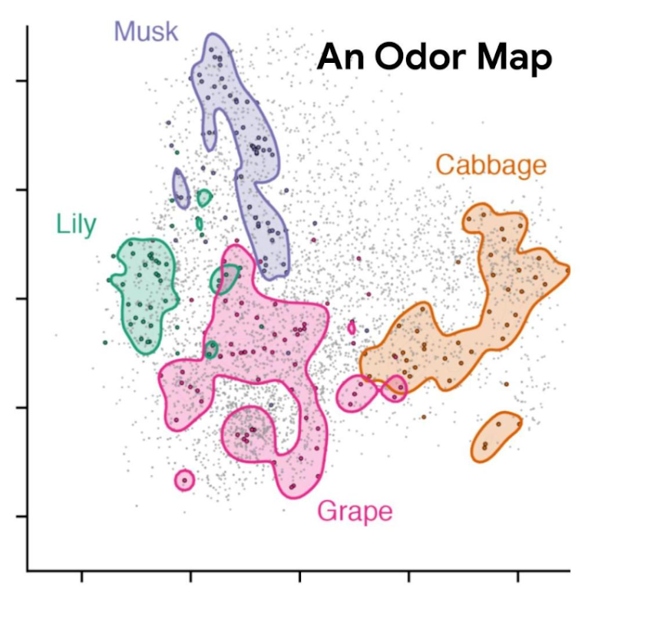
BackGround
POM-Principal Odor Map
1
2
3
4
5
6
Introduction
Importance of smell analysis
Introduction
The problem
Introduction
Our Solution
BackGround
BackGround
Previous Researches
BackGround
POM

Slide 8
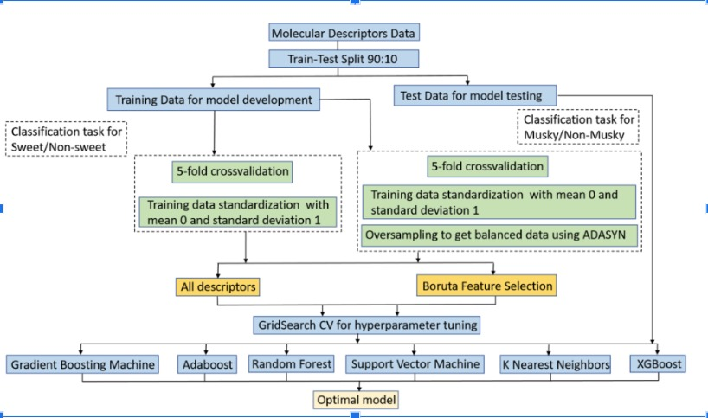
Architecture
Ensemble Learning
1
2
3
4
5
6
7
Introduction
Importance of smell analysis
Introduction
The problem
Introduction
Our Solution
BackGround
BackGround
Previous Researches
BackGround
POM
Architecture
8

Slide 9
Database
medicinal
melon
metallic
milky
musk
fishy
floral
fresh
fruit
skin
1
2
3
4
5
6
7
8
Introduction
Importance of smell analysis
Introduction
The problem
Introduction
Our Solution
BackGround
BackGround
Previous Researches
BackGround
POM
Architecture
Database

Slide 10
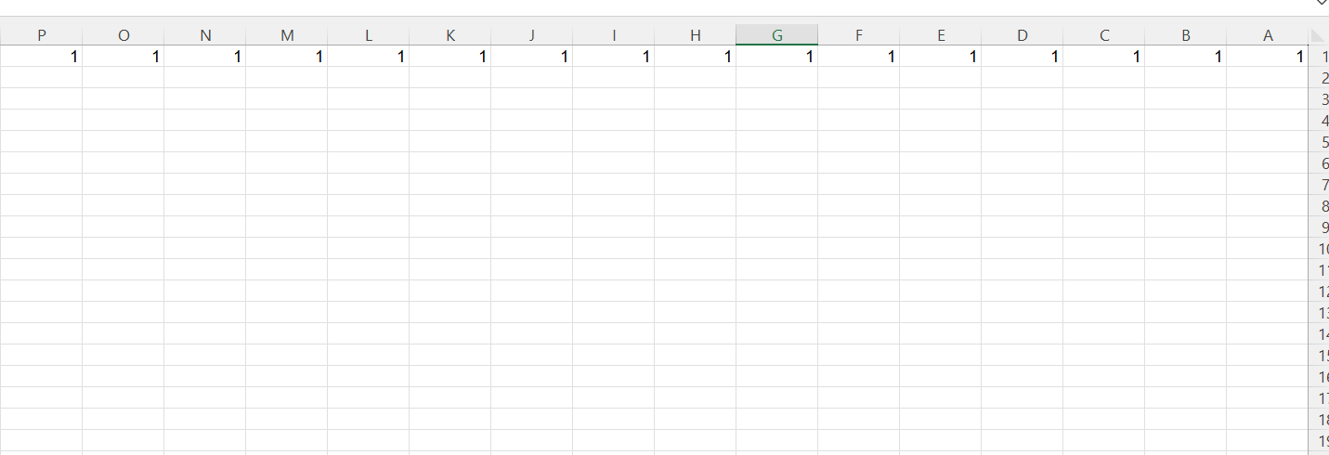
”Smelltify”-CSV File
1
2
3
4
5
6
7
8
9
Introduction
Importance of smell analysis
Introduction
The problem
Introduction
Our Solution
BackGround
BackGround
Previous Researches
BackGround
POM
Architecture
Database
”Smelltify”-CSV File

Slide 11
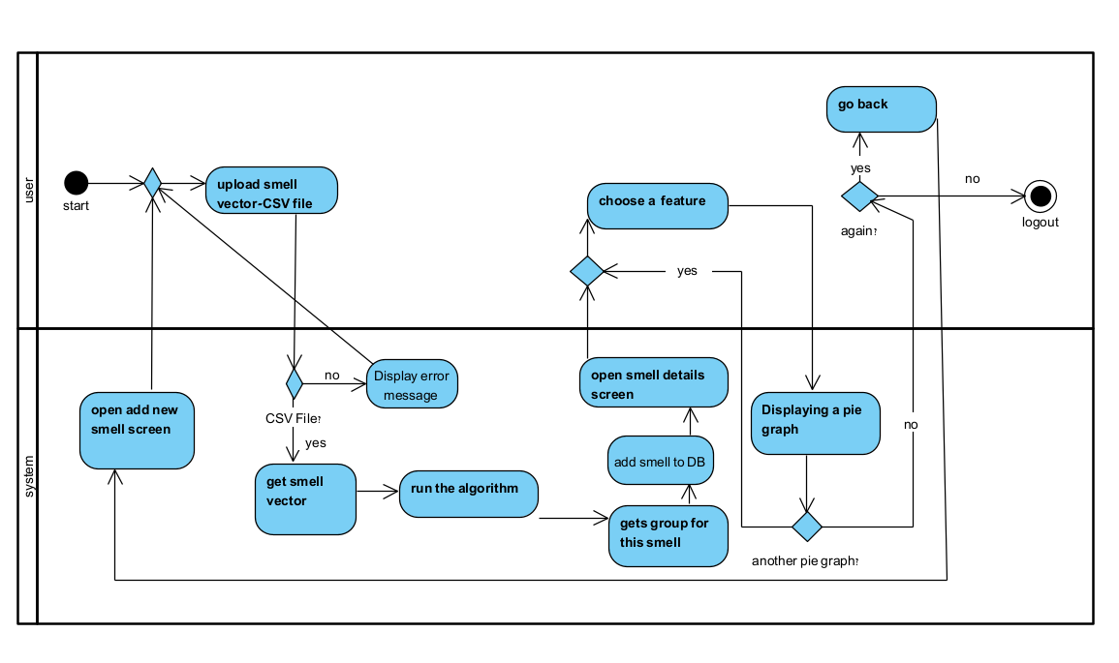
”Smelltify”
1
2
3
4
5
6
7
8
9
10
Introduction
Importance of smell analysis
Introduction
The problem
Introduction
Our Solution
BackGround
BackGround
Previous Researches
BackGround
POM
Architecture
Database
”Smelltify”-CSV File
“Smelltify”

Slide 12
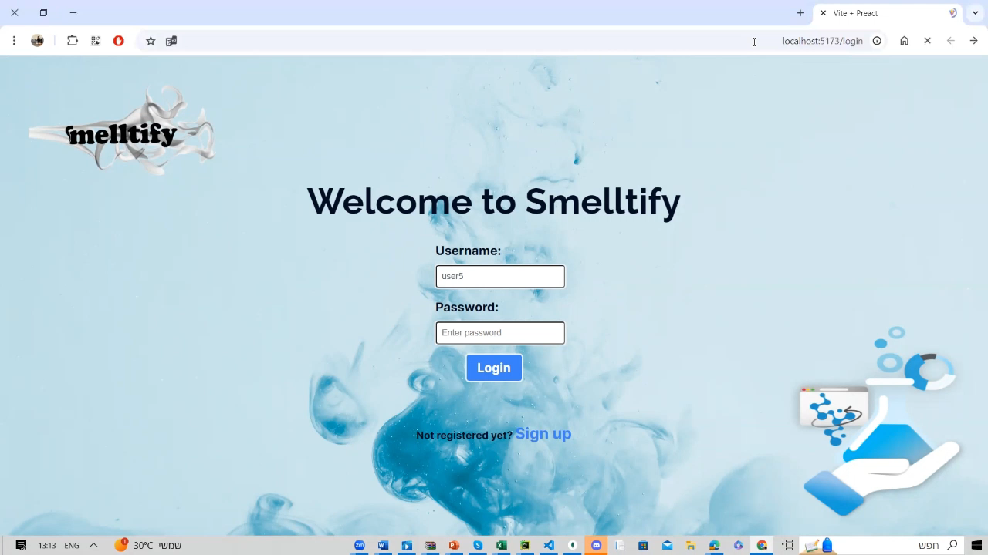
”Smelltify”
1
2
3
4
5
6
7
8
9
10
Introduction
Importance of smell analysis
Introduction
The problem
Introduction
Our Solution
BackGround
BackGround
Previous Researches
BackGround
POM
Architecture
Database
”Smelltify”-CSV File
“Smelltify”

Slide 13
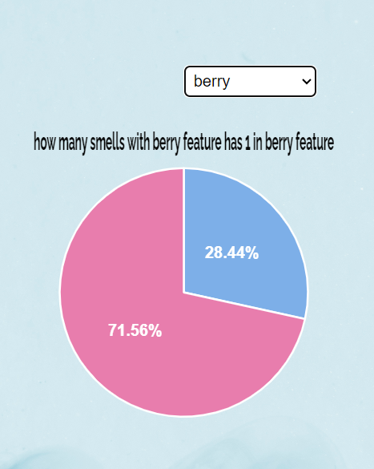
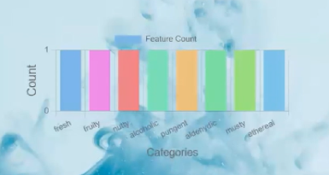
Graphs
1
2
3
4
5
6
7
8
9
10
11
Introduction
Importance of smell analysis
Introduction
The problem
Introduction
Our Solution
BackGround
BackGround
Previous Researches
BackGround
POM
Architecture
Database
”Smelltify”-CSV File
“Smelltify”
Graphs

Slide 14
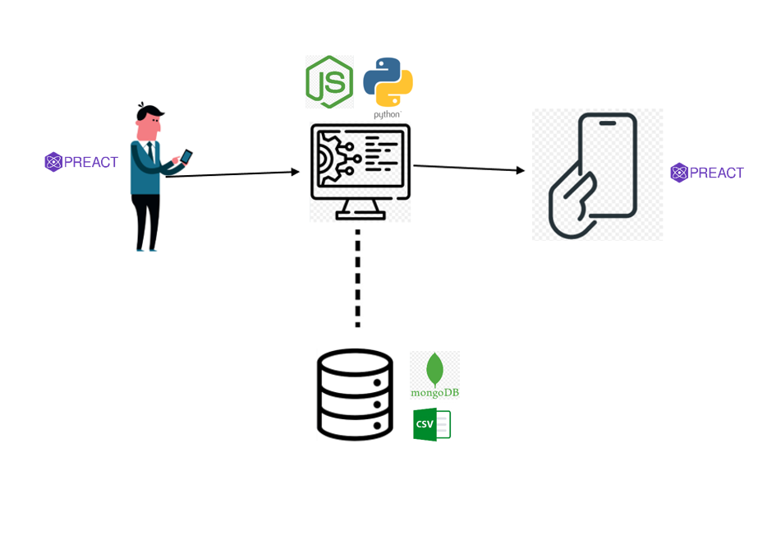
Architecture and Technologies
1
2
3
4
5
6
7
8
9
10
11
12
Introduction
Importance of smell analysis
Introduction
The problem
Introduction
Our Solution
BackGround
BackGround
Previous Researches
BackGround
POM
Architecture
Database
”Smelltify”-CSV File
“Smelltify”
Graphs
Architecture and Technologies

Slide 15
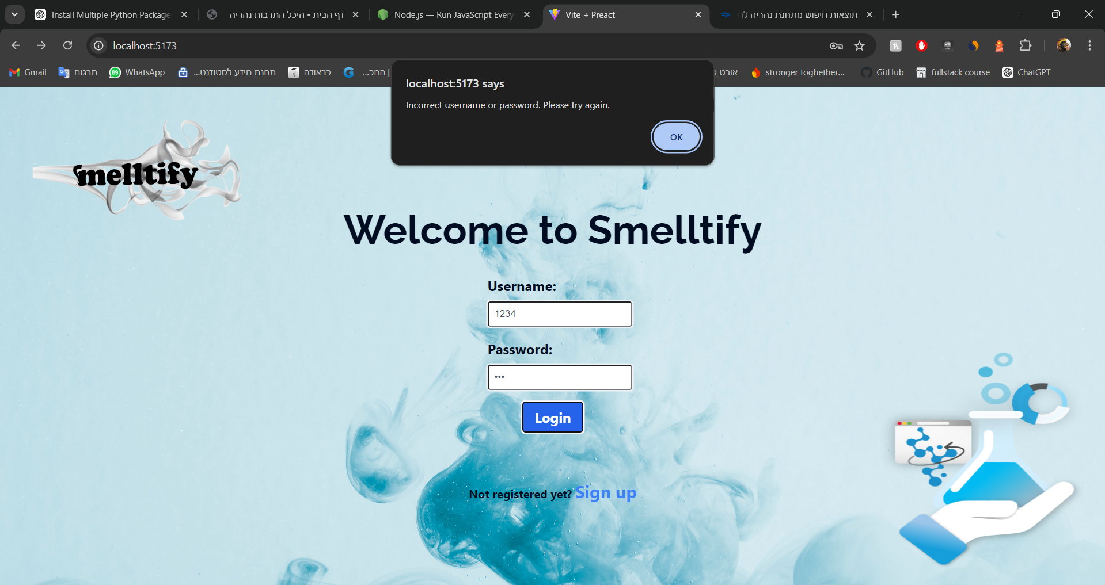
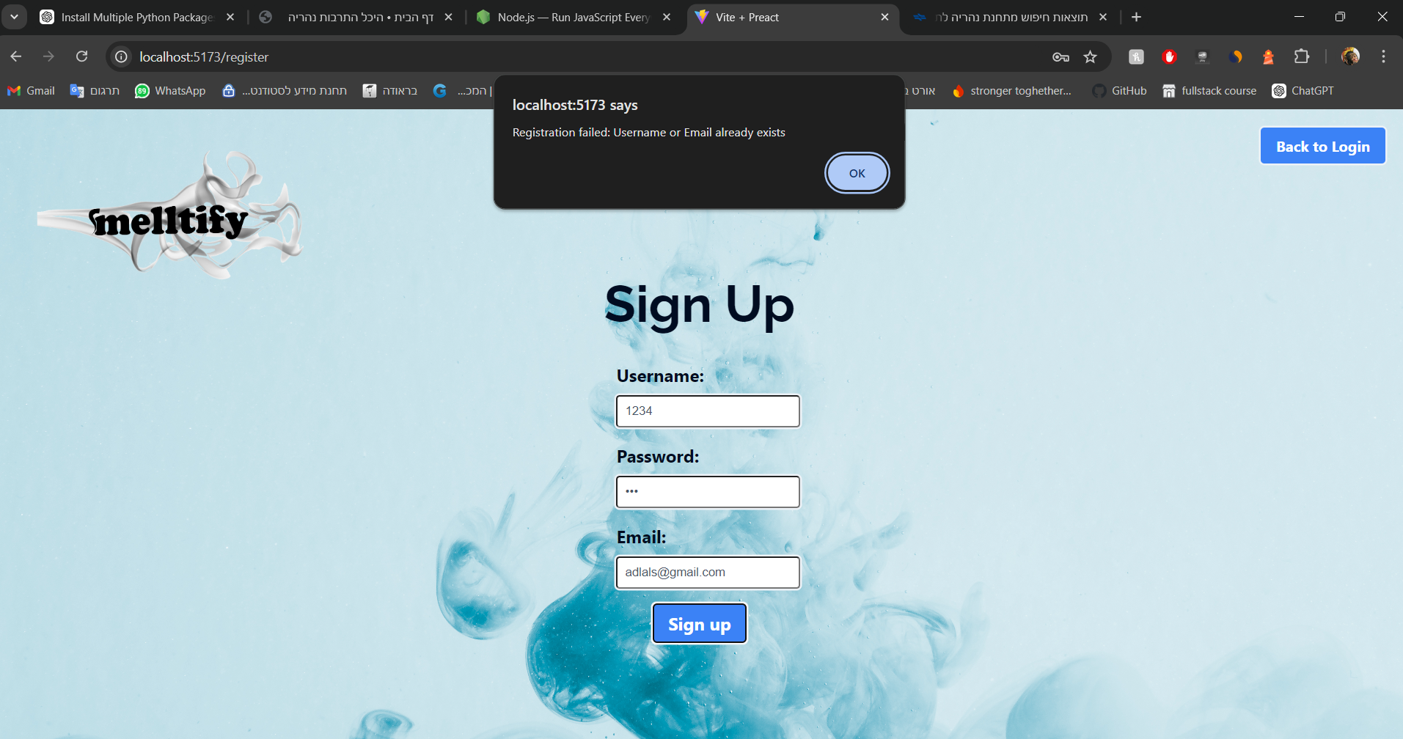
Our App-”smelltify”
Verification
Wrong password
Register existing user
1
2
3
4
5
6
7
8
9
10
11
12
13
Introduction
Importance of smell analysis
Introduction
The problem
Introduction
Our Solution
BackGround
BackGround
Previous Researches
BackGround
POM
Architecture
Database
”Smelltify”-CSV File
“Smelltify”
Graphs
Architecture and Technologies
Our App- Verification

Slide 16
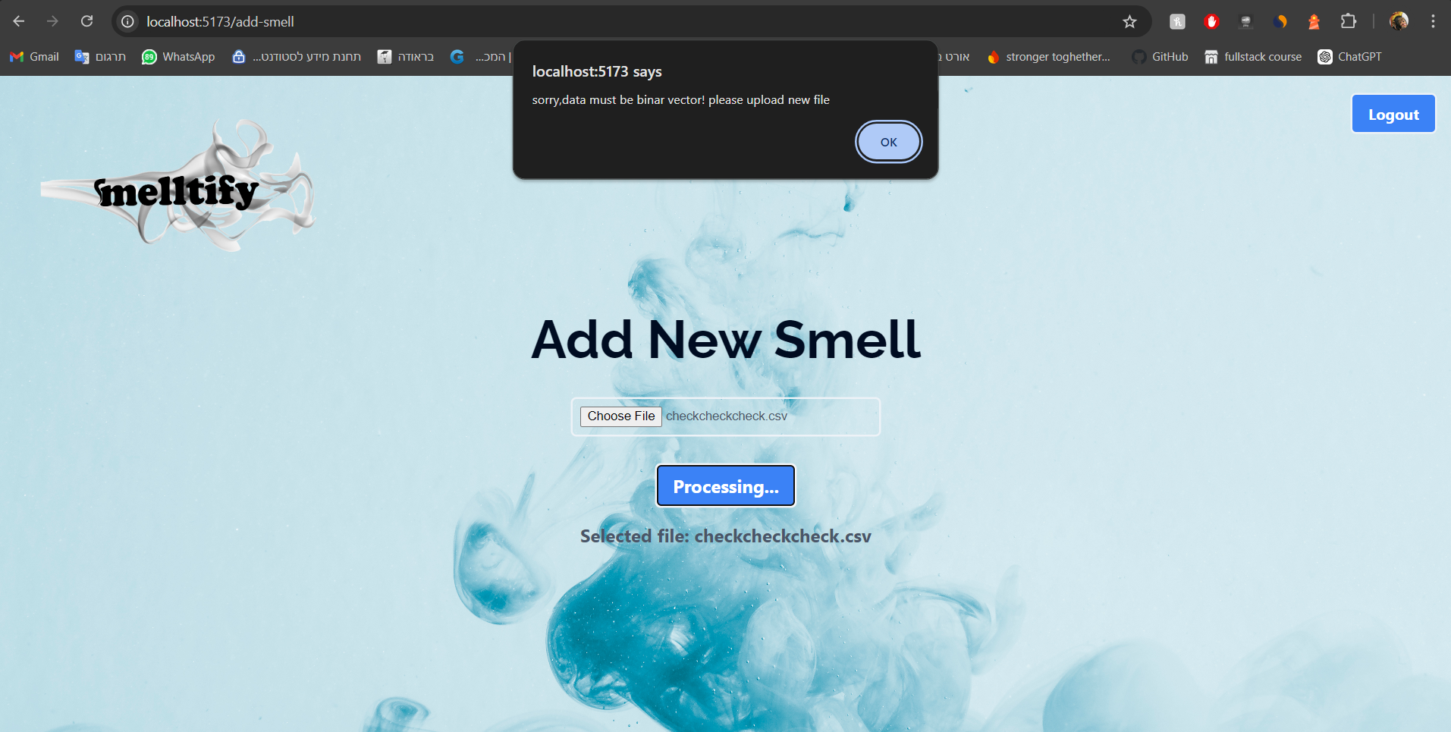
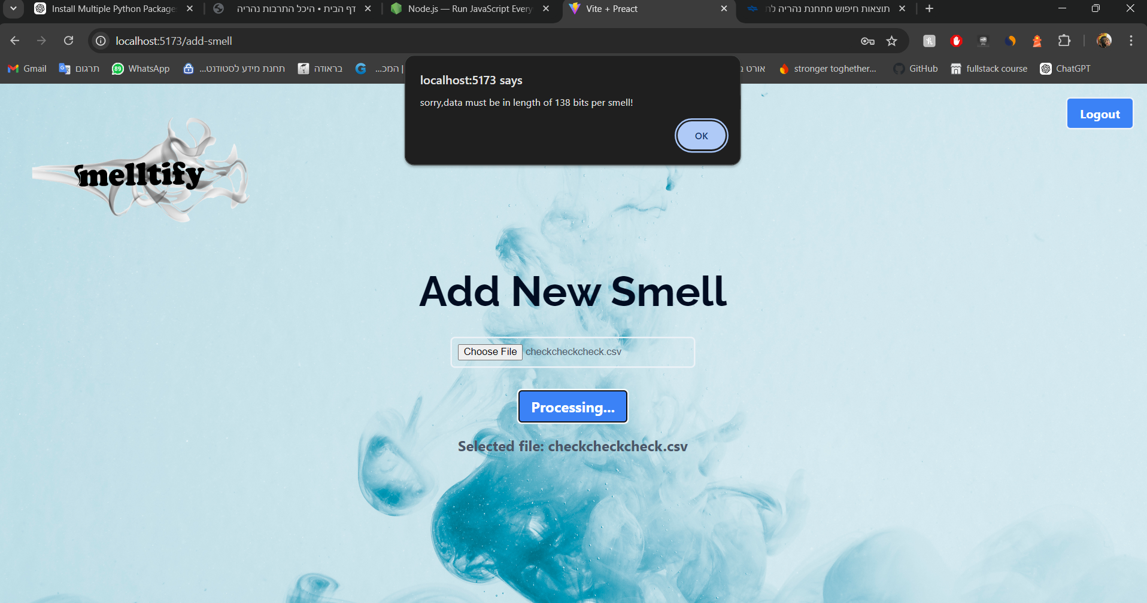
Our App-”smelltify”
Verification
CSV with non binar number
Too short CSV
1
2
3
4
5
6
7
8
9
10
11
12
13
Introduction
Importance of smell analysis
Introduction
The problem
Introduction
Our Solution
BackGround
BackGround
Previous Researches
BackGround
POM
Architecture
Database
”Smelltify”-CSV File
“Smelltify”
Graphs
Architecture and Technologies
Our App- Verification

Slide 17
Challenges and Solutions
New tools
Dataset limitations
Lack of time
1
2
3
4
5
6
7
8
9
10
11
12
13
14
Introduction
Importance of smell analysis
Introduction
The problem
Introduction
Our Solution
BackGround
BackGround
Previous Researches
BackGround
POM
Architecture
Database
”Smelltify”-CSV File
“Smelltify”
Graphs
Architecture and Technologies
Our App- Verification Plan
Challenges and Solutions

Slide 18
Results and conclusion
Best Model: Random Forest
Accuracy: 85% - 93%
Comparison with Previous Models:
POM Accuracy: 70%
Central Architecture (XGBoost) Accuracy: 83%
Feature Insights:
High Correlation Features: apple, berry, etc.
Low Correlation Features: alcoholic, balsamic, banana, etc.
1
2
3
4
5
6
7
8
9
10
11
12
13
14
15
Introduction
Importance of smell analysis
Introduction
The problem
Introduction
Our Solution
BackGround
BackGround
Previous Researches
BackGround
POM
Architecture
Database
”Smelltify”-CSV File
“Smelltify”
Graphs
Architecture and Technologies
Our App- Verification Plan
Challenges and Solutions
Results and Conclusion
18

Slide 19
Results and conclusion
Achievements:
Effective comparison of one smell against multiple smells.
Notable improvement in accuracy with Random Forest.
Conclusions:
Random Forest significantly outperformed previous models.
Improved feature creation and correlation understanding.
1
2
3
4
5
6
7
8
9
10
11
12
13
14
15
Introduction
Importance of smell analysis
Introduction
The problem
Introduction
Our Solution
BackGround
BackGround
Previous Researches
BackGround
POM
Architecture
Database
”Smelltify”-CSV File
“Smelltify”
Graphs
Architecture and Technologies
Our App- Verification Plan
Challenges and Solutions
Results and Conclusion

Slide 20
Thank you for listening

Slide 21
References
Gerkin, R. C., & Wiltschko, A. B. (2022). Digitizing smell: Using molecular maps to understand odor. Google AI Blog.
Chacko, R., Jain, D., Patwardhan, M., Puri, A., Karande, S., & Rai, B. (2020). Data based predictive models for odor perception. *Scientific Reports*. https://doi.org/10.1038/s41598-020-73978-1
. https://www.kaggle.com/datasets/aryanamitbarsainyan/multi-labelled-smiles-odors-dataset/data
. https://towardsdatascience.com/xgboost-the-definitive-guide-part-1-cc24d2dcd87a

